Slide 1
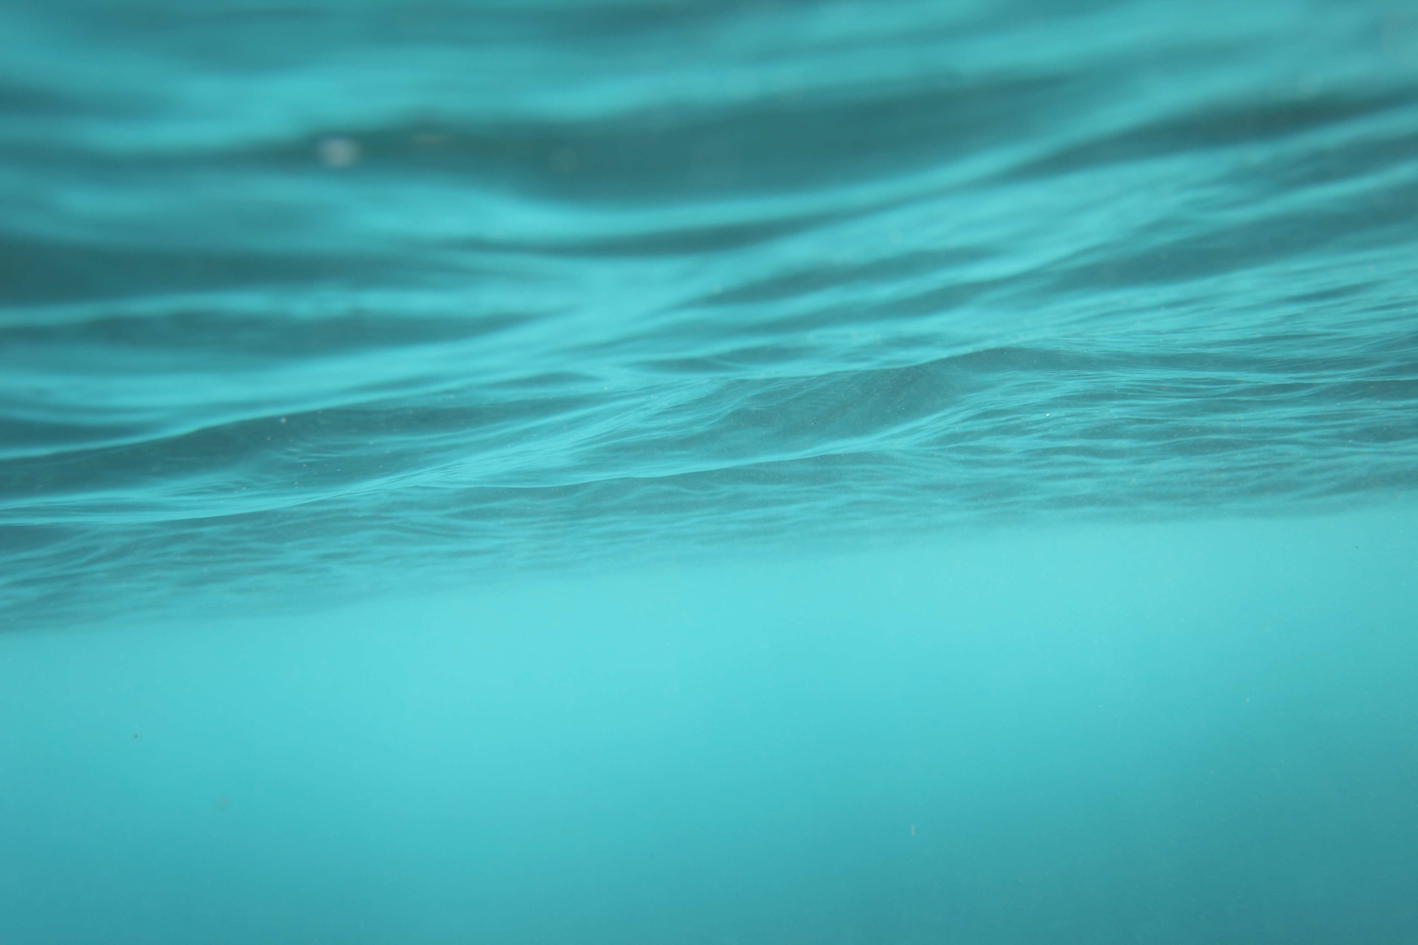
Importance of Water

Slide 2
WHY is Water Important?
WATER is important because:
ALL life forms depend on it to survive.
71% of the Earth's surface is water,
We cook FOOD with and drink water.
We can survive without food for a few days but we CANNOT without water.

Slide 3
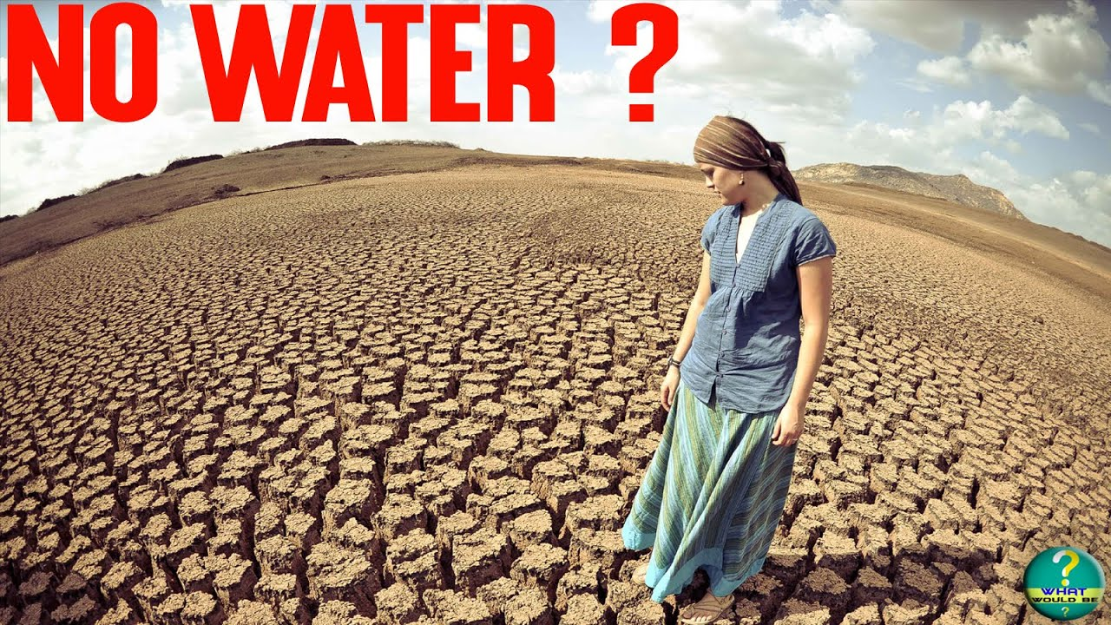
If water SUDDENLY disappeared …..
ALMOST ALL the life forms in the world would VANISH
For Eg., ALL the sea creatures would die except just a few amphibians.
If all plants died we would have no air to breathe and would all suffocate to DEATH.

Slide 4
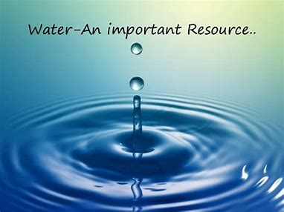
But what makes water so important?
Water has several unique characteristics that make it an extremely valuable resource. Some such properties of water are listed below:
Water is a very good solvent – it has the ability to dissolve many substances.
The boiling point and freezing point of water make it easily available in all three states (solid, liquid, and gaseous).
The specific heat of water is quite high. This enables water to absorb and release heat slowly, thereby regulating the temperature of its environment.

Slide 5
What more?
Owing to its transparency, water can allow light to reach the life forms that are submerged in it. This is crucial for the survival of plant life in the oceans, lakes, and rivers.
Water is neither acidic nor basic in nature. It has a pH of 7, making it a neutral substance.
These unique qualities of water, along with its abundance on the planet (approximately 71% of the Earth’s surface is made up of water), make it a crucial resource for plants, animals, and human beings.

Slide 6
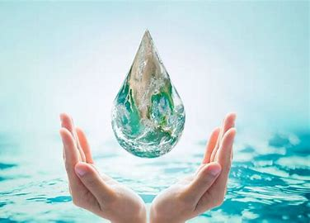
How Can We Save Water?
Use a bowl in the sink when washing fruit, vegetables of dishes. You can then use the waste water to water your plants.
Turn off the tap when you clean your teeth. A running tap uses up to nine litres of water a minute.
Depending on the size of your cistern, you could save between one and three litres each time you flush the toilet.

Slide 7
How Can We Save Water?
Wait until you have a full load before using your washing machine or your dishwasher. Some new washing machines use less than seven litres of water for each kilogram of clothes, while modern dishwashers can us as little as 10 to 15 litres of water a cycle.
If possible, take a shower instead of a bath. A five-minute shower uses about 40 litres of water. This is about half the volume of a standard bath.
Use a water-saving device in your toilet cistern.

Slide 8
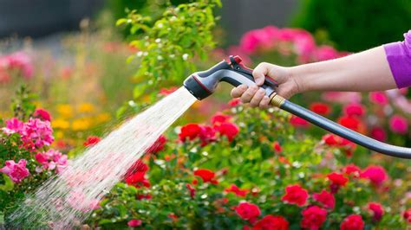
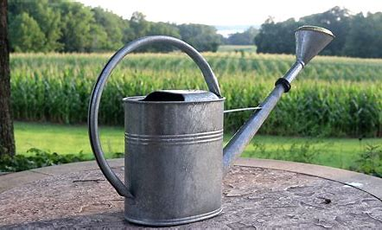
How Can We Save Water?
Garden sprinklers and hosepipes left running can use between 500 and 1,000 litres of water an hour.

Slide 9
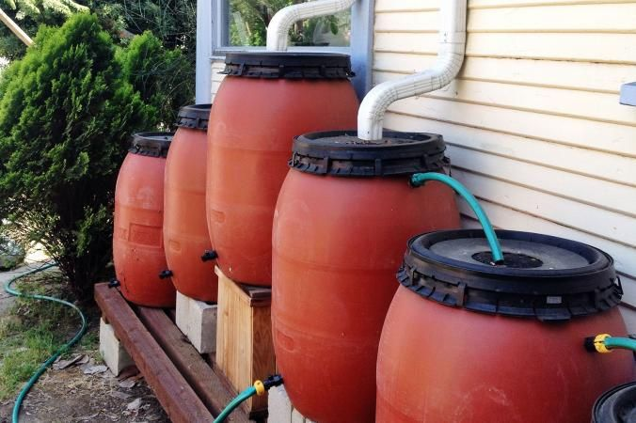
How Can We Save Water?
Think about fitting a water butt to collect rainwater off your roof. Water butts usually store about 200 litres of water. As well as being better for watering your plants, using rainwater in the garden reduces the amount of treated water you use.

Slide 10
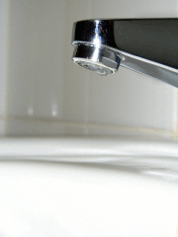
How Can We Save Water?
Check your property regularly for leaks on your internal plumbing.

Slide 11
What Would Happen if There WAS No Water?
For starters, it wouldn’t be quite so green for very long.
all vegetation would soon die out and the world would resemble a brownish dot, rather than a green and blue one.
Clouds would cease to formulate and precipitation would stop as a necessary consequence, meaning that the weather would be dictated almost entirely by wind patterns.

Slide 12
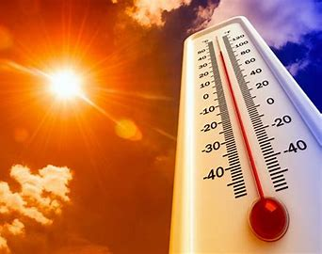
What Would Happen if There WAS No Water?
Indeed, other than fluctuations in wind force, our climate would resemble one endless summer – but not the shorts-and-t-shirt, holiday kind; the flesh-meltingly hot kind.

Slide 13
THANK YOU By Arya, Gautam and Hiya

